Slide 1
Caravan Insurance Policy Prediction
IST707- 21991
Jack Harris, Jessica Kwon

Slide 2

Caravan?
It is travel trailers!
Main question on this dataset was:
Can you predict who would be interested in buying a caravan insurance policy and give an explanation why?

Slide 3
Data Description
1

Slide 4
Data descriptions
9,822 records: 5,822 training records and 4,000 test records
For every customer, 86 attributes are given.
43 socio-demographic variables derived via the customer’s ZIP code.
43 variables about ownership of other insurance policies
Challenges
Feature selection and extraction can be difficult
Only 5 to 6% of the customers in the training data set actually buy the insurance policy.
All attributes are already discretized; some specific information has already been lost.

Slide 5
Initial Data
Exploration
2

Slide 6
Association Rule Mining
Support Level
Strong Predictor
10% of the positive case (5% of the data), which is 0.005.
Strong predictors of customer who would purchase a caravan insurance policy are the following:
AvgInc (=4 or 5)
PurchPowerClass (>=6)
ContribPriv3rdPartyIns (>= 0)
ContribCarPol (= 6)
ContribFirePol (>= 3)
NumBoatPol (=0)
Confidence Level
Minimum confidence level was set to 10%, which is 0.01.

Slide 7
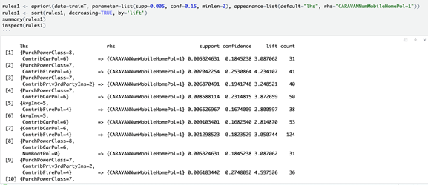
Association Rule Mining

Slide 8
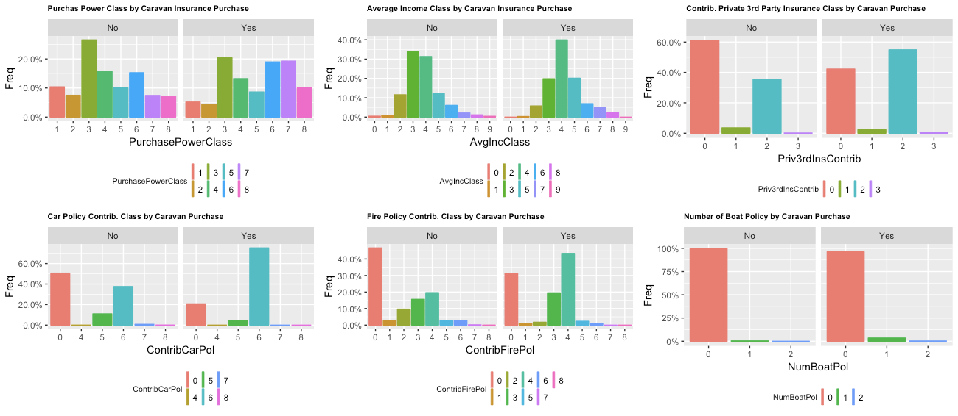
Distribution Graphs of Strong Predictors

Slide 9
Data
Modeling
3

Slide 10
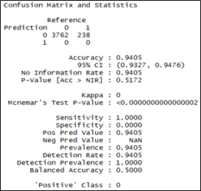
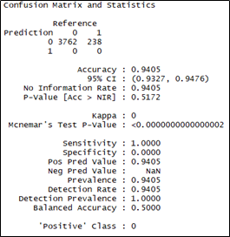
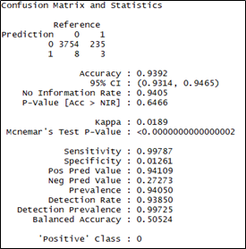
Data Modeling
Decision Tree
SVM
Random Forest

Slide 11
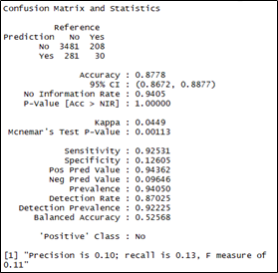
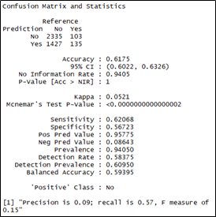
Data Modeling
Naive Bayes (all variables)
Naive Bayes (significant variables only)

Slide 12
Model Evaluation
4

Slide 13
Decision Tree, SVM, and Random Forest
The goal was to successfully predict which customers would purchase a caravan insurance policy (no = 0, yes = 1)
Dataset is unbalanced; less than 6% of cases are positive
Decision tree and SVM models predicted an outcome of 0 in every case. This resulted in a supposed accuracy rate of 94.05%, but gives a balanced accuracy of 50%
Random forest fared slightly better, but still failed to take into account the unbalanced nature of the dataset. Balanced accuracy of 50.524%

Slide 14
Naive Bayes
Naive Bayes was completed twice; once with all variables, and then once with only the six variables earlieridentified as significant
With all variables, the balanced accuracy was 52.568%
With significant variables only, the balanced accuracy was 59.395%

Slide 15
Conclusions
Regression techniques and association rule mining were used to identify the strongest predictors
Using naive Bayes with strong predictors only resulted in best model performance.
The strongest predictor was contribution to a car insurance policy of $1,000 or higher. A higher purchasing power class or possession of a boat insurance policy also seemed significant
This represents actionable data, specifically regarding targeted advertising. Customers with higher incomes, who purchase higher levels of insurance, are the ideal target for a marketing campaign for purchasing caravan insurance.

Slide 16
Conclusions
5

Slide 17
Thanks!
Any questions?

